Slide 1
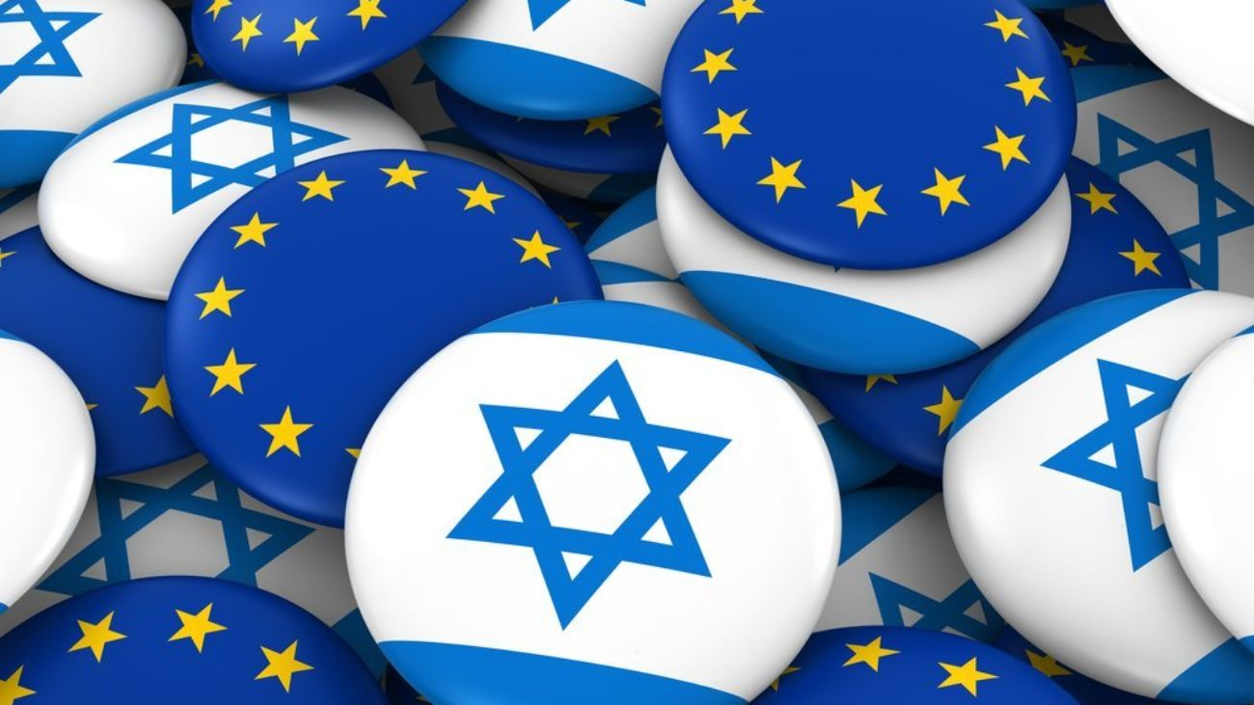
HU-EF Barometer
Mutual Perceptions - Israel & Germany, France,
Great Britain and Poland
2026

Slide 2
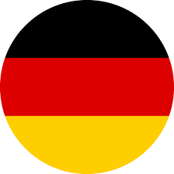


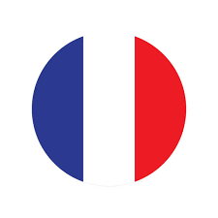
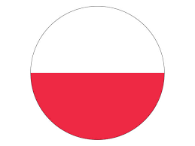

Methodology
Online survey, conducted by
4 European countries: Germany, UK, France & Poland
In addition, a “Benchmark” study conducted in Israel.
Representative sample, 1,000 participants in each country
Dates of fieldwork:
Germany: June – July 2026
Great Britain: June – July 2026
France: June – July 2026
Poland: June – July 2026
Israel (Jews) : May 2026
Israel (Arabs) : May 2026
Questionnaire length: 8 min.
Sampling error: 3.1% per Total market sample
Regions:
East: 25%, North: 19%, South: 30%, West: 26%
Regions:
Midlands : 23%, North: 25%, Scotland & N.Ireland: 8%, Southeast : 28%, Wales & West : 15%
Regions:
Nord et Est : 15%, Ouest: 28%, Region Parisienne
: 18%, Sud-Est : 20%, Sud-Ouest: 20%
Regions:
Centralny: 23%, Makroregion Pólnocno Zachodni: 14%, Makroregion Pólnocny: 13%, Makroregion Poludniowo Zachodni: 11%, Makroregion Poludniowy: 21%, Wschodni: 17%
General sector: 502 participants ; Arab sector: 250 participants, Orthodox Jew: 251

Slide 3
ISRAEL: Jewish Israelis report a strengthened sense of Israeli identity, while Arab Israelis rather say that say their identity has weakened
Impact on identity following the 7th of October war and the Iran war

Slide 4
Israel: A substantial number of respondents think Israel is the safest place for a Jew to live. Opinions differ significantly between Jews and Arabs
Safety: Israel vs. Europe
N=1003
N=753
N=250

Slide 5
A perception gap exists between Israelis and Europeans. Israelis view Israel as the safest place for Jews to live. Poland stands out from the other European countries, with the highest proportion (35%) viewing Israel as the safer option
Safety: Israel vs. Europe

Slide 6
ISRAEL: 54 percent of the respondents see it as important to fight for liberal democracy. Jewish Israelis are more likely than Arabs to view their country as leading the West's fight against radicalism.
To what extent do you agree or disagree with the statement…
“It is important to fight for liberal democracy."
“Israel is at the forefront of the West’s fight against radicalism"

Slide 7
Support for liberal democracy is shared across countries. When it comes to Israel’s role in fighting against radicalism, Poland is a notable outlier, showing substantially lower agreement that Israel is leading the fight of the West against radicalism.
To what extent do you agree or disagree with the statement…
“It is important to fight for liberal democracy."
“Israel is at the forefront of the West against radicalism"

Slide 8



42 percent of the Israeli respondents consider their country more like a Middle Eastern country. 18 percent liken it to an European country. The number of Arab respondents who consider Israel today more like a Middle Eastern country has more than tripled compared to 2022
How would do you define Israel? (%)
N=1,003
N=753
N=250
In your opinion, is Israel more like a European country, a Middle Eastern country or a country like the United States?

Slide 9

Israel: Higher rates than in 2024 disagree with the statement: “the EU is a success”.
Is the EU a success? (%)
N=1,003
N=753
N=250
To what extent do you agree or disagree with the statement: “The EU is, in general, a success”.
*In the 2022 the answers were – “Success”, “Failure”. Please note that in this chart – success is compared to “Total agreement”, and Failure is compared to “Total disagreement”.

Slide 10
ISRAEL: Similar to 2024 a large majority of the Jewish respondents are in favour of maintaining ties with far-right parties in Europe, if these parties support Israel.
Should Israel maintain ties with Far-right parties from EU countries ? (%)
In Parliaments of several EU countries there are far-right wing parties, some of which support Israel when it comes to the Israeli- Palestinians conflict. Do you agree or disagree with the statement that Israel's representatives should maintain ties with such parties?
*In the 2022 the answers were – “Yes”, “No”. Please note that in this chart – Yes is compared to “Total agreement”, and No is compared to “Total disagreement”.

Slide 11
ISRAEL: Fewer respondents in comparison to 2024 see the strengthering of the far right party AFD in Germany as a dangerous development, most of those say it is no more than in other countries.
Is the AFD party gaining more power in Germany a dangerous development? (%)
In Germany, the far-right party AFD has gained significant power. Do you consider this as a dangerous development?

Slide 12
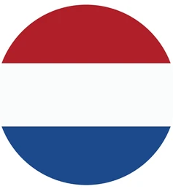
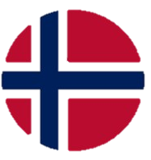



ISRAEL: Germany, followed by Hungary, are considered to be the greatest friends to Israel (among a list of nine countries)
Who is perceived as a friend of Israel? (%)
Total sample
Total Jewish sector
Arab sector
Which one of the following countries do you consider a friend of Israel?
Notes:
NEW SLIDE 7/4/24

Slide 13
ISRAEL: France and Spain are thought to be the most Antisemitic countries.
Who is perceived as antisemitic? (%)
Total Sample
Total Jewish
Arab sector
2026
2026
2026
Which of these countries do you consider to be the most antisemitic?
Please choose another 2 countries you consider to be antisemitic.

Slide 14

Israeli perception of Germany – timeline since 1992
The “different Germany” perception (% among Jews)
Base: Jews

Slide 15
According to groups
The “different Germany” perception (%)
N=1003
N=753
N=250
Do you think todays Germany is a "different Germany" compared to the era before 1945?

Slide 16
ISRAEL: Older Jewish respondents think more than younger ones that there is a “Different Germany“.
The “different Germany” perception (% among different age groups)
N=262 | N= 443 | N= 298 | N= 189 | N= 316 | N= 248 | N= 73 | N= 127 | N= 50
Do you think todays Germany is a "different Germany" compared to the era before 1945?

